Slide 1
Prediction of Pollutant Concentrations

Slide 2
Problem Description
Utilize different Machine learning models to predict Pollutant levels in major cities within Texas for the next 1 hour, 6 hours, 12 hours, 18 hours and 24 hours

Slide 3
Dataset Description
Data is obtained from Texas Commission for Environment Quality
Major cities where pollutant levels is to be detected: Austin, Houston, San Antonio, Dallas
Dataset timespan: 1st January 2000 – 31st December 2017
Independent Input Parameters: Wind Speed, Wind Direction, Temperature, Previous hours Pollutant concentration
Output Parameter: Ozone concentration(Parts per billion)
Size of Original Dataset: 150 GB
Training set: Data from year 2000 to 2016
Test set: Data in year 2017

Slide 4
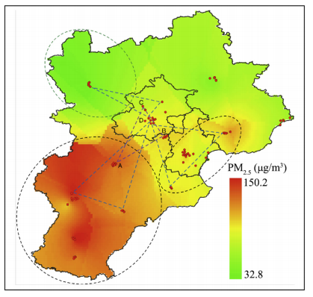
Air Trajectory Analysis
Theory: The pollutants from site A get transported to site B or site C based on the wind speed and direction

Slide 5
Major challenges in the Project
Size of the data – 150GB
Cleaning the data – Converting the dataset into the required/appropriate format
Handling missing data – Most sites in the data files don’t have data for all years. In most cases, over the entire time span, most sites have more than 80% of missing data

Slide 6
Data Structures for analysis
There are three possible data structures for developing the machine learning models
Input parameters: Pollutant Level, Wind along x direction, Wind along y direction, Temperature
Data Structure 1(Plain Model)
  This data structure contains only the input parameters for that particular site
Data Structure 2(Hybrid Model)
  This data structure contains the input parameters for all sites
Data Structure 3
  This data structure contains the input parameters along with the sites latitude and longitude for that particular site

Slide 7
Data Structure Tables Columns
Data Structure 1: Inputs/Columns
Day of the month | Month Name | Hour of the Day | Site 1
 |  |  | Wind along X direction | Wind along y direction | Temperature | Pollutant Level
Data Structure 2: Inputs/Columns
Day of the month | Month Name | Hour of the Day | Site 1 Parameters |  |  |  | ………. | Site N Parameters
 |  |  | Wind along X direction | Wind along y direction | Temperature | Pollutant Level |  | Wind along X direction | Wind along y direction | Temperature | Pollutant Level
Data Structure 3: Inputs/Columns
Latitude | Longitude | Day of the month | Month Name | Hour of the Day | Wind along X direction | Wind along y direction | Temperature | Pollutant Level

Slide 8
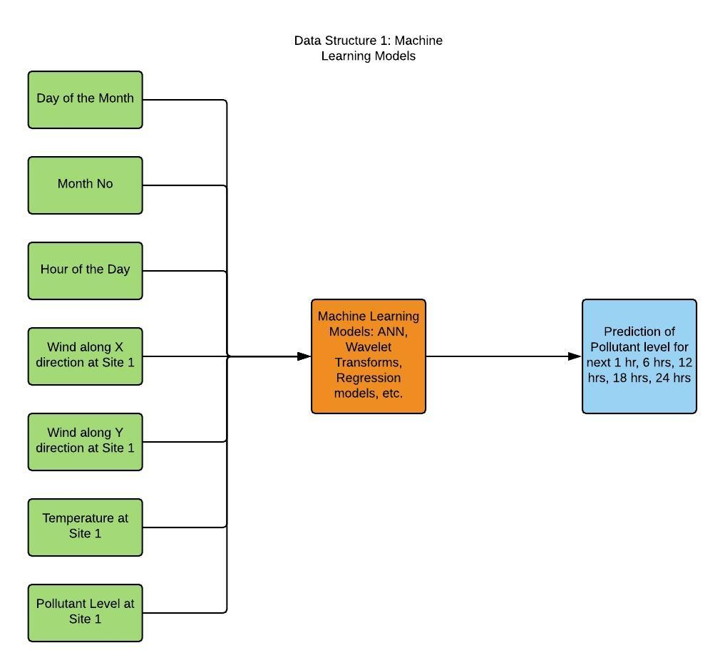
Machine Learning Model Inputs: Data Structure 1

Slide 9
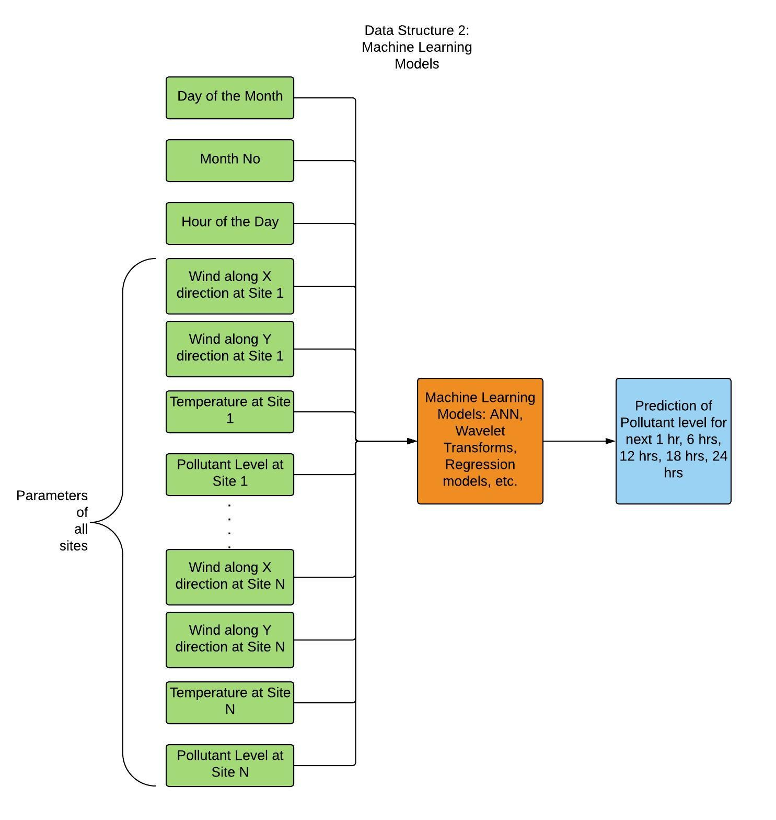
Machine Learning Model Inputs: Data Structure 2

Slide 10
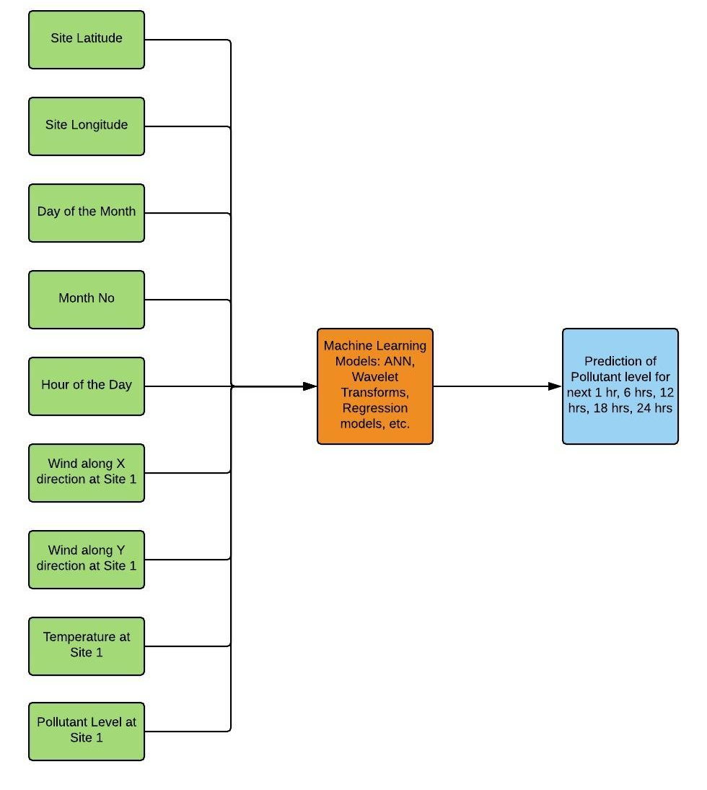
Machine Learning Model Inputs: Data Structure 3

Slide 11
Perks of different Datastructures
Data Structure 1 (the plain model), is the simplest model and utilizes only the input parameters for that particular site to predict the output.
Data Structure 2, is a more complicated model which is trying to replicate the analysis done in Beijing, utilizes the input parameters for all available sites to predict the output. In Beijing, they made predictions for 4 sites, whereas in our case it is about 10 sites per region or more. Another issue is that, due to missing data in many areas, we had to shortlist 71 sites from a total of about 300 sites.
Data Structure 3, is a more practical model, we use the site latitude and longitude along with the main input parameters. Also, in the case of this data structure, we will need to only develop one type of machine learning model for all sites whereas in the other data structures, for one type of machine learning model we have to repeat the same model for all other sites, leading to a large no of models. Also, we can use most of the data from all 300 sites.

Slide 12
No of Models required for each Data Structure Type
 | No of sites |  |  | ANN Model |  |  | SVM Regression Models |  |  | Random Forest Classifier Models |  |  | Regression Models
Pollutant | Data Structure 1 | Data Structure 2 | Data Structure 3 | Data Structure 1 | Data Structure 2 | Data Structure 3 | Data Structure 1 | Data Structure 2 | Data Structure 3 | Data Structure 1 | Data Structure 2 | Data Structure 3 | Data Structure 1 | Data Structure 2 | Data Structure 3
Ozone | 71 | 71 | All Sites | 71 | 71 | 1 | 71 | 71 | 1 | 71 | 71 | 1 | 71 | 71 | 1
PM2.5 | 48 | 48 | All Sites | 48 | 48 | 1 | 48 | 48 | 1 | 48 | 48 | 1 | 48 | 48 | 1
NOX | 62 | 62 | All Sites | 62 | 62 | 1 | 62 | 62 | 1 | 62 | 62 | 1 | 62 | 62 | 1
NO2 | 64 | 64 | All Sites | 64 | 64 | 1 | 64 | 64 | 1 | 64 | 64 | 1 | 64 | 64 | 1
SO2 | 46 | 46 | All Sites | 46 | 46 | 1 | 46 | 46 | 1 | 46 | 46 | 1 | 46 | 46 | 1
Total No of Models |  |  |  | 291 | 291 | 5 | 291 | 291 | 5 | 291 | 291 | 5 | 291 | 291 | 5

Slide 13
Performance of different Models for data structure 1 and 2
Site | R2 score |  |  |  | Training Error |  |  |  | Test Error
 | Plain ANN | Hybrid ANN model | Plain Regression Model | Hybrid Regression Model | Plain ANN | Hybrid ANN model | Plain Regression Model | Hybrid Regression Model | Plain ANN | Hybrid ANN model | Plain Regression Model | Hybrid Regression Model
48_027_1045 | 0.934405 | 0.92963 | 0.919429 | 0.906676 | 13.05758 | 7.109656 | 16.04918 | 10.77464 | 13.99083 | 15.00925 | 17.18514 | 19.90508
48_027_1047 | 0.92275 | 0.922181 | 0.921625 | 0.88436 | 14.7938 | 6.358263 | 15.32748 | 11.25483 | 13.98364 | 14.08668 | 14.18733 | 20.93291
48_029_0032 | 0.906126 | 0.9111 | 0.899424 | 0.886211 | 22.53114 | 10.31249 | 23.87164 | 17.92577 | 19.07182 | 18.06117 | 20.43327 | 23.11766
48_029_0052 | 0.892092 | 0.867174 | 0.88785 | 0.842447 | 23.06924 | 9.95585 | 24.97308 | 17.80274 | 25.97447 | 31.97251 | 26.99562 | 37.92434
48_029_0059 | 0.904605 | 0.915303 | 0.903697 | 0.887133 | 16.50018 | 8.417295 | 16.89368 | 12.47585 | 18.40839 | 16.34386 | 18.5835 | 21.77983
48_029_0622 | 0.916937 | 0.923495 | 0.921119 | 0.917616 | 14.784 | 8.634304 | 15.20046 | 11.72826 | 16.82945 | 15.50082 | 15.98219 | 16.69186
48_039_0618 | 0.905403 | 0.901124 | 0.908086 | 0.854699 | 29.63555 | 15.90125 | 31.06516 | 22.90105 | 19.6231 | 20.5106 | 19.06656 | 30.14098
48_039_1004 | 0.915506 | 0.924898 | 0.910499 | 0.90504 | 21.95292 | 8.725025 | 24.03306 | 16.19655 | 22.21753 | 19.74796 | 23.53423 | 24.96963
48_039_1016 | 0.907705 | 0.912938 | 0.902463 | 0.842644 | 21.33845 | 9.614022 | 22.751 | 16.93146 | 19.85056 | 18.72506 | 20.97804 | 33.84389
48_061_0006 | 0.92896 | 0.907564 | 0.917574 | 0.91112 | 11.75697 | 7.753074 | 13.46537 | 11.04644 | 10.78881 | 14.03821 | 12.51798 | 13.49809
48_061_1023 | 0.914059 | 0.925493 | 0.915453 | 0.914317 | 12.2447 | 6.285092 | 12.2838 | 9.514881 | 13.7968 | 11.96122 | 13.57298 | 13.75545
48_085_0005 | 0.92093 | 0.917997 | 0.919513 | 0.898089 | 15.70124 | 6.709458 | 16.05195 | 11.80887 | 14.94144 | 15.49561 | 15.20912 | 19.25752
48_113_0069 | 0.904535 | 0.912037 | 0.900112 | 0.905055 | 23.90818 | 9.853001 | 25.42036 | 18.17331 | 22.68979 | 20.90672 | 23.74096 | 22.56611
48_113_0087 | 0.895796 | 0.889283 | 0.894475 | 0.894858 | 18.38636 | 7.942309 | 18.80283 | 14.48127 | 17.99604 | 19.12088 | 18.22423 | 18.15795
48_121_0034 | 0.92456 | 0.926312 | 0.921923 | 0.912703 | 20.48871 | 9.981651 | 21.52226 | 15.2132 | 18.28834 | 17.86382 | 18.92764 | 21.16278

Slide 14
Models Performance on different sites based on Test Error
 | Plain ANN Model | Hybrid ANN model | Plain Regression Model | Hybrid Regression Model
No of Sites | 22 | 35 | 5 | 9
Percentage of Sites | 0.309859 | 0.492958 | 0.070423 | 0.126761

Slide 15
Future Models/ Suggestions
Utilize data structure 3 as it becomes more simpler and does not require a separate machine learning model for each site.
Utilize wavelet transform on the output variables to improve accuracy
Develop SVM regression and random forest classifier models
Develop data visualization for the changing wind trajectories and pollutant levels
Develop dashboard

